Slide 1









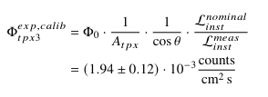
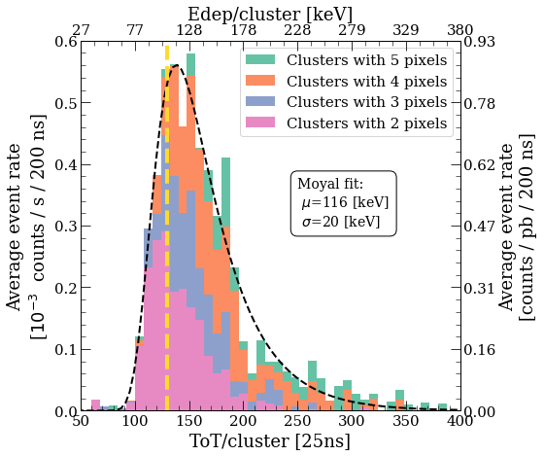
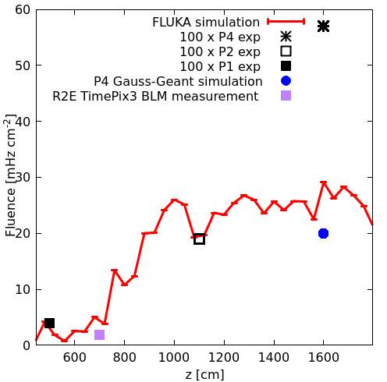


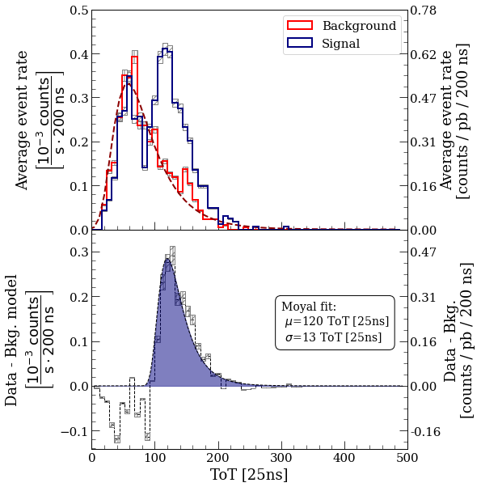
Measurement of the transversal Muon Rate at the proposed CODEX-b experiment with the Timepix3 Radiation Monitor
Daniel Prelipcean*, Giuseppe Lerner, A. Ciccotelli, F. Cerutti, A. Zimmaro, James Storey
CERN (CH-1211 Geneva), *Corresponding author: daniel.prelipcean@cern.ch
1. Introduction
4. Timepix3 Count rate
Using the Timepix3 Radiation Monitor [1], a test campaign at the proposed COmpact Detector for EXotics at LHCb (CODEX-b) [2-4] location in the Large Hadron Collider (LHC) [5] was performed, aiming to measure the (transversal) muon rate during proton-proton (pp) luminosity production at the LHCb detector [6], at LHC Interaction Point 8 (IP8). The results are compared with both dedicated simulations [7] performed with the FLUKA.CERN [8–10] Monte Carlo code, as well as previous measurements [11].
The background is fitted using a Moyal distribution and then subtracted from the signal histogram. Then, the signal thus obtained is fitted as well
using a Moyal distribution revealing a peak at the expected energy, as shown in Fig. 1. This procedure is applied for all clusters from 𝑁 = 2 up to 5 pixels. From the merged 2- to 5-pixel cluster signals, we obtain a total average event rate, shown in Fig. 2, normalized to the Timepix3 detector area A_{tpx}=2.12 cm² the acceptance angle Θ=15.17◦, and the nominal LHCb luminosity rate, as:
2. Muon Signal
In the D1 cavern at IP8, only muons and possibly neutrons are assumed to arrive, as the other particles would stop within the massive concrete shieldings. The infrastructure of the LHCb cavern generally stops muons with momentum below 𝑝_{𝑡ℎ𝑟𝑒𝑠} ≈ 1500 MeV/c. The slowed-down muon momenta at the detector position peaks around a momentum of 𝑝 ≈ 200 MeV/𝑐 [11], close to the MIP regime with roughly constant stopping power 𝑑𝐸/𝑑𝑥|_{𝑆𝑖} ≈ 4.15 MeV/cm in Silicon. Considering the track length inside the sensitive volume, the energy deposition of muons coming from IP8 in the Timepix3 sensor is expected to be approximately:
3. Signal and Background Selection
Fig. 2: (Left) The full reconstructed signal using 2- to 5-pixel clusters, fitted with a Moyal distribution (black dashed curve), revealing a peak at the expected energy deposition value of 107 keV (yellow dashed vertical line). (Right) Comparison of muon fluence from FLUKA simulations and measurements. This study adds the Timepix3
measurement (purple square), compared to the previous measured results using scintillating fibers reported in Ref. [11]. The assumed luminosity rate production was the nominal (levelled) 0.45 nb⁻¹/s.
The signal discrimination from background is done using the directionality of the incoming muons, by analysing their tracks inside the detector pixel array, forming multi-pixel clusters. The 𝑥 (𝑦) axis of the detector was placed parallel
(perpendicular) to the normal from the IP, in order to discriminate the muons coming from the collision point and those that constitute the background. The detector has been oriented with an incidence (polar) angle of 𝜃 = 15° wrt. to the normal from the IP (i.e. wrt. the incoming muons). This choice has been made because a particle that arrives at an angle of Θ^{𝑚𝑎𝑥}_{𝑚𝑜𝑛𝑜 𝑝𝑖𝑥𝑒𝑙} = 12° or larger must interact with at least two pixels of the detector, thereby allowing to filter the signal by the number of pixels in the particle track, while minimally compromising on the acceptance angle with a 1/cos 𝜃 factor.
Geometrically, from the installation location, the Timepix3 Radiation Monitor result corresponds to a data point at 𝑧 = 700 cm, where the FLUKA simulations of LHCb is reported in Ref. [7] at:
where we considered a systematic simulation uncertainty of 𝜎_{𝑠𝑦𝑠𝑡}^{𝑠𝑖𝑚} = 20% (benchmark studies of this complexity usually have an agreement of a few tens percent [7]).
5. Conclusions
In summary, a successful background measurement campaign was held to measure the muon flux rate in the proposed CODEX-b location, during LHCb pp luminosity production.
The lower energy threshold of the Timepix3 Radiation Monitor allowed to measure a slight increase in the instantaneous count rate during luminosity production, with a Signal-to-Noise Ratio of about 2. The measured energy deposition spectrum matches the expected value for minimum ionizing muons, confirming the capability of the setup to identify beam-induced muons at IP8.
The muons originating from the proton-proton pp collision point are only aligned along one direction in the detector plane, allowing to geometrically discriminate the signal from the background.
The Timepix3 measured count rate was compared to dedicated FLUKA simulations, matching the normalized predictions with a ratio of simulated to measured data of 𝑅_{Φ} = 1.96 ± 48%. The agreement within a factor of 2 confirms that the collision-induced muon background in the D1 cavern is well understood and within expected levels.
Fig. 1: (Top panel) Time-over-Threshold (ToT) distribution of the 2-pixel clusters aligned along the x-direction, for signal and background data sets. The background is fitted using a Moyal distribution and subtracted from the signal. (Bottom panel) Signal after the background subtraction, fitted using a Moyal distribution, revealing a clear peak at the expected signal location and along the expected direction.
References
D. Prelipcean et al, Towards a Timepix3 Radiation Monitor for the Accelerator Mixed Radiation Field: Characterisation with Protons and Alphas from 0.6 MeV to 5.6 MeV. in Applied Sciences 14, no. 2: 624, January 2024. DOI: 10.3390/app14020624.
V. V. Gligorov et al, “Searching for long-lived particles: A compact detector for exotics at LHCb”, Phys. Rev. D, vol. 97, p. 015 023, 1 2018. doi:10.1103/PhysRevD.97.015023.
G. Aielli et al, “Expression of Interest for the CODEX-b Detector”, Eur. Phys. J. C, vol. 80, no. 12, p. 1177, 2020. doi:10.1140/epjc/s10052-020-08711-3
G. Aielli et al, “The Road Ahead for CODEX-b”, Tech. Rep., 2022. https://cds.cern.ch/record/2805287
O. S. Brüning et al., LHC Design Report, CERN Yellow Report, 2004. doi:10.5170/CERN-2004-003-V-1
LHCb Collaboration, “The LHCb Detector at the CERN Large Hadron Collider”, JINST, vol. 3, S08005, 2008. doi:10.1088/1748-0221/3/08/S08005
A. Ciccotelli et al., “Energy deposition studies for the Upgrade II of LHCb at the CERN Large Hadron Collider”, Phys. Rev. Accel. Beams, vol. 27, p. 061 003, 6 2024. doi:10.1103/PhysRevAccelBeams.27.061003
FLUKA website. URL https://fluka.cern.
FLUKA.CERN Collaboration. New Capabilities of the FLUKA Multi-Purpose Code. Frontiers in Physics, 9, 2022. ISSN 2296-424X. URL https://www.frontiersin.org/article/10.3389/fphy.2021.788253 .
FLUKA.CERN Collaboration. Overview of the FLUKA code. Annals Nucl. Energy, 82:10–18, 2015. DOI: 10.1016/j.anucene.2014.11.007.
B. Dey et al., Background studies for the CODEX-b experiment: measurements and simulation, 2019. doi:10.48550/ARXIV.1912.03846

